Slide 1
Software Testing Methodologies
Prashant Joshi

Slide 2
Module 2: Agenda
Module 2: Mathematics & Formal Methods
Topic 2.1
Permutations & Combinations
Topic 2.2
Propositional Logic
Topic 2.3
Discrete Math
Topic 2.4
Graph Theory

Slide 3
Math for Test Engineers
For Test Engineers – Know our focus
Testing is a craft; math are the craftsman’s tools
Bring Rigor, Precision and Efficiency
Our treatment of math
Largely informal – What is required for Test Engineers and not for mathematicians
Our focus is discrete mathematics
Aim is
To make test engineers better at their craft

Slide 4
Topic 2.1: Permutations & Combinations

Slide 5
Permutation & Combination
Selecting several things out of a larger group
Two aspects to look at
Order
Repetition

Slide 6

Combination
Order does not matter
Example: Fruits in a fruit salad. It does not matter in which the fruits are put into the salad. It could be Apple, Banana and Strawberry or any other order

Slide 7

Permutation
Order does matter
Example: A lock which opens with a sequence of digits. We call it the combination lock. It is indeed a permutation lock
Sequence 437 (347 will never work!)
Indeed a permutation lock

Slide 8
Permutation
Repetition – Yes & No
Example
Repetition allowed: Digits in the permutation lock may repeat like “333” or “557”
Repetition now allowed: First three standings in a running race

Slide 9


Permutation
Choosing r things out of n
Repetition
n possibilities for each of the r choices
Without Repetition
Possibilities reduce with every selection
$$n^{r}$$
$$\frac{n!}{\left(n−r\right)!}$$

Slide 10


Combination
Choosing r things out of n
Repetition allowed
Without Repetition
$$\frac{\left(n+r−1\right)!}{r!\left(n−1\right)!}$$
$$\frac{n!}{r!\left(n−r\right)!}$$

Slide 11
Software Testing Methodologies
Prashant Joshi

Slide 12
Topic 2.2: Propositional Logic

Slide 13
Propositional Logic
A proposition is a sentence that is either TRUE or FALSE
Given a proposition, it is always possible to tell if it is T or F
Propositional logic has operations, expressions, and identities
Logical Operators
Logical Expressions
Logical Equivalence

Slide 14
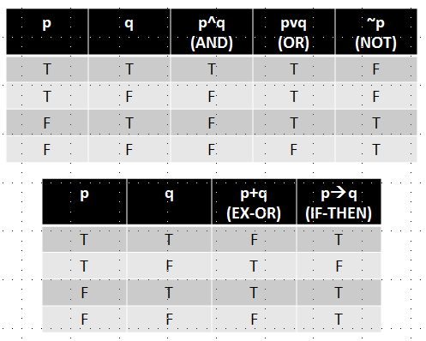
Propositional Logic

Slide 15
Software Testing Methodologies
Prashant Joshi

Slide 16
Topic 2.3: Discrete Math

Slide 17
Propositional Logic
A proposition is a sentence that is either TRUE or FALSE
Given a proposition, it is always possible to tell if it is T or F
Propositional logic has operations, expressions, and identities
Logical Operators
Logical Expressions
Logical Equivalence

Slide 18
Propositional Logic

Slide 19
Topic 2.3: Discrete Math

Slide 20
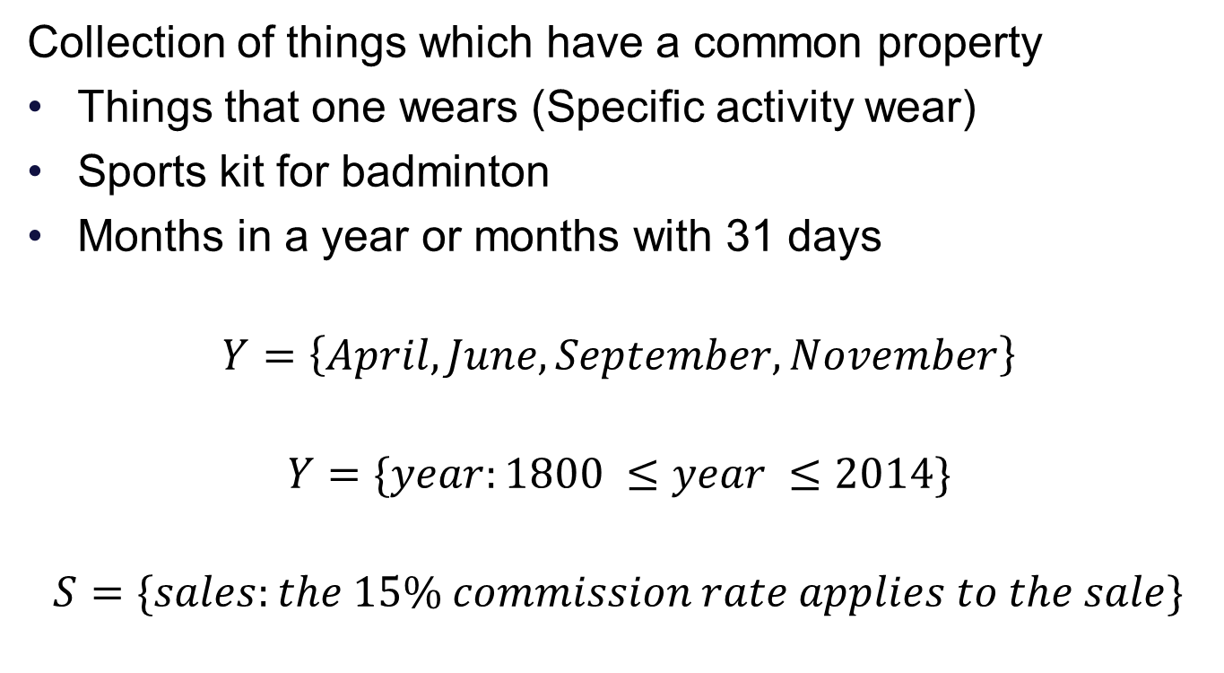
Set Theory
Collection of things which have a common property
Things that one wears (Specific activity wear)
Sports kit for badminton
Months in a year or months with 31 days
$$Y=\left\{April, June, September, November\right\}$$
$$Y=\{year:1800 ≤year ≤2014\}$$
$$S=\{sales:the 15\% commission rate applies to the sale\}$$
Listing Elements
Decision rule
Decision rule

Slide 21
Venn Diagrams
Picture(s) for Sets
A set of depicted as a circle with interior of the circle corresponds to the elements of the set
U
April
November
September
June
Venn diagram of 30 day month

Slide 22
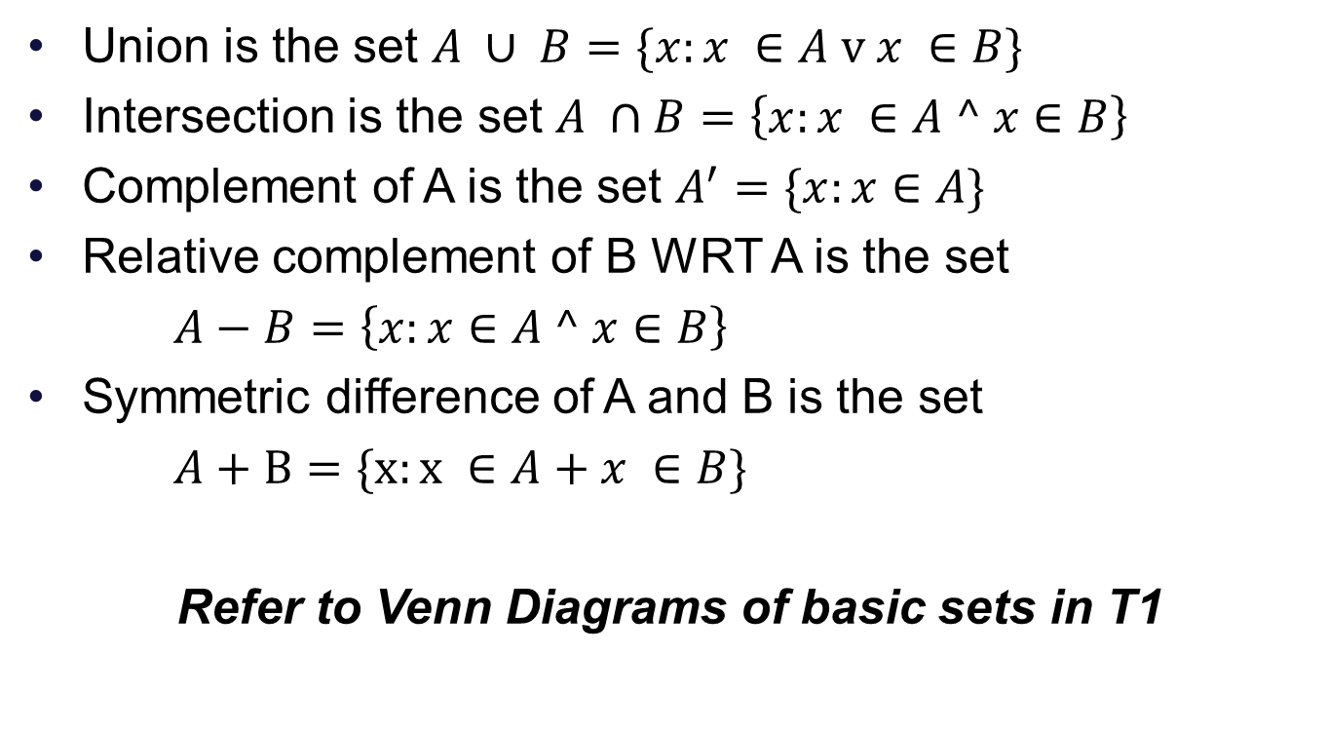
Set Operations
Union is the set $A ∪ B=\{x:x ∈A \text{v} x ∈B\}$
Intersection is the set $A ∩B=\left\{x:x ∈A ^ x∈B\right\}$
Complement of A is the set $A^{′}=\{x:x∈A\}$
Relative complement of B WRT A is the set
$A−B=\left\{x:x∈A ^ x∈B\right\}$
Symmetric difference of A and B is the set
$A+B=\{x:x ∈A+x ∈B\}$
Refer to Venn Diagrams of basic sets in T1

Slide 23

Set Operations
Unordered pair $(a, b)$
Ordered pair $<a, b>$
What is the difference?
Cartesian Product
$$A ×B=\{<x, y>:x ∈A ^ y ∈B\}$$

Slide 24
Set Relations
Subset
A is subset of B if and only if all elements of A are also in B
Proper subset
A is a proper subset of B if and only if there is at least one element in B which is not in A
Equal Sets
Each is a subset of the other
Look up the notations in the book T1 Chapter 3

Slide 25
Set Partitions
Particularly important for test engineers
Divide the whole in parts
Given a set B, and a set of subsets A1, A2…, An of B, the subsets are a partition of B iff
$A1 ∪A2 ∪ … ∪An=B$, and
$$i ≠j⇒Ai ∩Aj= ∅$$

Slide 26
Software Testing Methodologies
Prashant Joshi

Slide 27
Topic 2.4: Graph Theory

Slide 28
Graph
A graph (also known as linear Graph) is an abstract mathematical structure defined from two sets – set of nodes and set of edges that form connections between nodes
Example: Computer Network
Definition
A Graph G = (V,E) is composed of a finite (and nonempty) set V of nodes and a set of E of unordered pairs of nodes

Slide 29
A Graph
Nodes and Edges Sets
Connection between nodes
n1
n2
n5
e1
e4
e2
n3
n3
n7
e3
e5
n6

Slide 30
Use of representation
Nodes as program statements
Edges
Flow of control
Define/use relationships

Slide 31
Degree of a Node
The degree of a node in a graph is the number of edges that have that node as an endpoint deg(n)
deg(n1) = 2
deg(n2) = 2
deg(n7) = 0
n1
n2
n5
e1
e4
e2
n3
n3
n7
e3
e5
n6

Slide 32
Use of Degree of Node
Indicates Popularity
Social scientists
Social interactions
Friendship/communicates with
Example:
Graph with nodes are objects and edges are messages; degree can represent the extent of integration testing that is appropriate for the object

Slide 33
Incidence Matrix
The incidence matrix is a graph G=(V,E) with m nodes and n edges is a m x n matrix, where the element in row i, column j is a 1 if and only if node i is an endpoint of edge j; otherwise the element is 0
 | e1 | e2 | e3 | e4 | e5
n1 | 1 | 1 | 0 | 0 | 0
n2 | 1 | 0 | 0 | 1 | 0
n3 | 0 | 0 | 1 | 0 | 0
n4 | 0 | 1 | 1 | 0 | 1
n5 | 0 | 0 | 0 | 1 | 0
n6 | 0 | 0 | 0 | 0 | 1
n7 | 0 | 0 | 0 | 0 | 0

Slide 34
Use of this representation
Degree of node is zero
Unreachable node

Slide 35
Adjacency Matrix
Deals with connections
The adjacency matrix of a Graph G=(V,E) with m nodes is an m x m matrix, where the element in row i, column j is 1 if and only if an edge exists between node i and node j; otherwise, the element is 0
 | n1 | n2 | n3 | n4 | n5 | N6 | n7
n1 | 0 | 1 | 0 | 1 | 0 | 0 | 0
n2 | 1 | 0 | 0 | 0 | 1 | 0 | 0
n3 | 0 | 0 | 0 | 1 | 0 | 0 | 0
n4 | 1 | 0 | 1 | 0 | 0 | 1 | 0
n5 | 0 | 1 | 0 | 0 | 0 | 0 | 0
n6 | 0 | 0 | 0 | 1 | 0 | 0 | 0
n7 | 0 | 0 | 0 | 0 | 0 | 0 | 0

Slide 36
Use of this representation
Deals with connections
Useful for later graph theory concepts example: paths

Slide 37
Paths
A path is a sequence of edges such that for any adjacent pair of edges e_{i}, e_{j} in the sequence, the edges share a common (node) endpoint
Path | Node Sequence | Edge Sequence
Between n1 and n5 | n1, n2, n5 | e1, e4
Between n6 and n5 | n6, n4, n1, n2, n5 | e5, e2, e1, e4
Between n3 and n2 | n3, n4, n1, n2 | e3, e2, e1

Slide 38
Graph
n1
n1 represents a series of statements
n7 also represents a series of statement
Is this the correct representation?
How does this help us get to testing?
What does this help in?
n2
n3
n4
n5
n6
n7

Slide 39
Software Testing Methodologies
Prashant Joshi

